Slide 1
6. Computing Packet Round-Trip Time
Intrusion Detection Module
Stephen Huang
Stephen Huang
Department of Computer Science
University of Houston

Slide 2
1. The Problem: Hacker Attack
Source IP: 111.22.33.44
Destination IP: 123.45.67.890

Slide 3
Interactive Session
No IP spoofing

Slide 4
Stepping Stone

Slide 5
Assumptions
Encrypted communication,
TELNET or Secured Shell (SSH) connections,
There is no valid reason to telnet through 4-5 hosts to reach a destination,

Slide 6
Connection Chain
Host 0
Host i-1
Host i
Host i+1
Host T
Target Victim
Upstream Downstream
Figure 1: A Sample Connecting Chain

Slide 7
2. Previous Work [Yung02]
R_{T}: the roundtrip time for a packet to travel from the host to the target machine and (echo) back,
R_{N}: the acknowledge time from this host to the next host,
Does not work very well.

Slide 8
Connection Chains
R_{T}
Host 0
Host 1
Host 2
Host 3
Host 4
R_{N}
Host 0
Host 1
Host 2
Host 3
Host 4

Slide 9
Our Approach
Objectives:
Real-time algorithm,
More accurate estimation of round trip time,
Use the changes in the roundtrip time to detect a new connection,
Gives an estimated number of chain length.

Slide 10
Hypotheses
If a connection chain is increased by one, we should see the round trip time (RRT) increase by certain amount.
Subject to fluctuation, RRT is an increasing function of the length of the chain.

Slide 11
Connection Chain
Upstream Downstream
Host 0
Host 1
Host 2
Host 3
Host 4

Slide 12
Connection Chain
Upstream Downstream
Host 0
Host 1
Host 2
Host 3
Host 4

Slide 13
Connection Chain
Upstream Downstream
Host 0
Host 1
Host 2
Host 3
Host 4

Slide 14
Connection Chain
Upstream Downstream
Host 0
Host 1
Host 2
Host 3
Host 4

Slide 15
Round-Trip Time

Slide 16
SEND Pointers
SND.UNA: The sequence number of the first byte of data that has been sent but not yet acknowledged.
SND.NXT: The sequence number of the next byte of data to be sent to the other device.
SND.WND: The size of the send window.

Slide 17
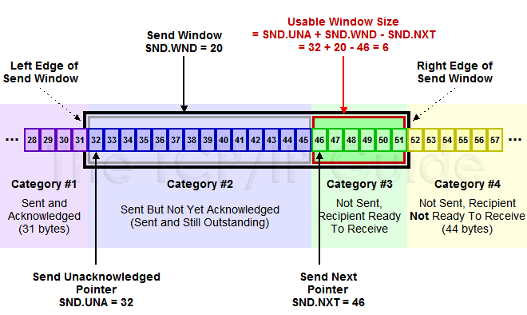

Slide 18
Receiver Pointer
RCV.NXT: The sequence number of the next byte of data that is expected from the other device.
RCV.WND: The size of the receive window “advertised” to the other device.

Slide 19
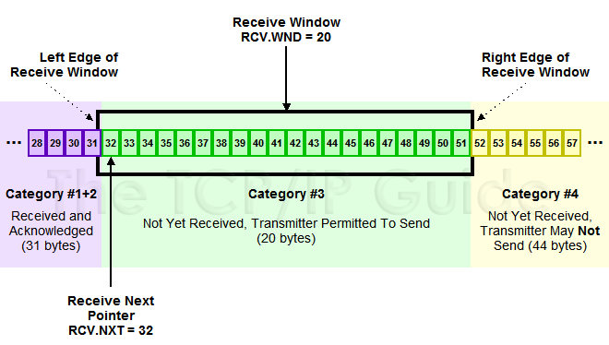

Slide 20
Transmission Control Block
Sequence Number: Identifies the sequence number of the first byte of data in the segment being transmitted.
This will normally be equal to the value of the SND.UNA pointer at the time that data is sent.
Acknowledgment Number: Acknowledges the receipt of data by specifying the sequence number that the sender of the segment expects in the segment recipient's next transmission.
This field will normally be equal to the RCV.NXT pointer of the device that sends it.
Window: The size of the receive window of the device sending the segment (and thus, the send window of the device receiving the segment.)

Slide 21
Example
Since the window sizes (SND.WND and RCV.WND) do not change, we do not displacy them in the following example.
Client
SND.UNA | SND.NXT | SND.WND | RCV.NXT | RCV.WND
1 | 1 | 360 | 241 | 200
Server
SND.UNA | SND.NXT | SND.WND | RCV.NXT | RCV.WND
241 | 2411 | 200 | 1 | 360

Slide 22
Example
Initialization
Client |  |  |  | Server
SND.UNA | SND.NXT | RCV.NXT |  | SND.UNA | SND.NXT | RCV.NXT
1 | 1 | 241 |  | 241 | 241 | 1
Send a Request of 140 bytes
Client |  |  |  | Server
SND.UNA | SND.NXT | RCV.NXT |  | SND.UNA | SND.NXT | RCV.NXT
1 | 141 | 241 |  | 241 | 241 | 1
Wait

Slide 23
Example
Received, sends an 80-byte ack reply
Client |  |  |  | Server
SND.UNA | SND.NXT | RCV.NXT |  | SND.UNA | SND.NXT | RCV.NXT
141 | 141 | 241 |  | 241 | 321 | 141
Received, sends an ack
Client |  |  |  | Server
SND.UNA | SND.NXT | RCV.NXT |  | SND.UNA | SND.NXT | RCV.NXT
141 | 141 | 321 |  | 241 | 321 | 141

Slide 24
Example
Send part 1 of a file (120/280 bytes)
Client |  |  |  | Server
SND.UNA | SND.NXT | RCV.NXT |  | SND.UNA | SND.NXT | RCV.NXT
141 | 141 | 321 |  | 241 | 441 | 141
Received, sends an ack
Client |  |  |  | Server
SND.UNA | SND.NXT | RCV.NXT |  | SND.UNA | SND.NXT | RCV.NXT
141 | 141 | 441 |  | 241 | 441 | 141

Slide 25
Example
Received ack for reply
Client |  |  |  | Server
SND.UNA | SND.NXT | RCV.NXT |  | SND.UNA | SND.NXT | RCV.NXT
141 | 141 | 441 |  | 321 | 441 | 141
wait
Client |  |  |  | Server
SND.UNA | SND.NXT | RCV.NXT |  | SND.UNA | SND.NXT | RCV.NXT
141 | 141 | 441 |  | 321 | 441 | 141

Slide 26
Example
Received Ack for file
Client |  |  |  | Server
SND.UNA | SND.NXT | RCV.NXT |  | SND.UNA | SND.NXT | RCV.NXT
141 | 141 | 441 |  | 441 | 441 | 141
Send part 2 of File (280-120)
Client |  |  |  | Server
SND.UNA | SND.NXT | RCV.NXT |  | SND.UNA | SND.NXT | RCV.NXT
141 | 141 | 441 |  | 441 | 601 | 141

Slide 27
Example
Send part 2 of File (280-120)
Client |  |  |  | Server
SND.UNA | SND.NXT | RCV.NXT |  | SND.UNA | SND.NXT | RCV.NXT
141 | 141 | 601 |  | 441 | 601 | 141
Received pat 2, send ack
Client |  |  |  | Server
SND.UNA | SND.NXT | RCV.NXT |  | SND.UNA | SND.NXT | RCV.NXT
141 | 141 | 601 |  | 441 | 601 | 141

Slide 28
Example
Received ack for file
Client |  |  |  | Server
SND.UNA | SND.NXT | RCV.NXT |  | SND.UNA | SND.NXT | RCV.NXT
141 | 141 | 601 |  | 601 | 601 | 141

Slide 29
TCP Segment Fields
Sequence Number: Identifies the sequence number of the first byte of data in the segment being transmitted.
This will normally be equal to the value of the SND.UNA pointer at the time that data is sent.
Acknowledgment Number: Acknowledges the receipt of data by specifying the sequence number that the sender of the segment expects in the segment recipient's next transmission.
This field will normally be equal to the RCV.NXT pointer of the device that sends it.
Notes:
http://www.tcpipguide.com/free/t_TCPSlidingWindowDataTransferandAcknowledgementMech-4.htm

Slide 30
First-Match Algorithm
Problem: Send and Echo packets are not 1-1.
Solution: Match every “Echo” packet with the first (the oldest) unmatched “Send” packet.
A queue is used to store all the unmatched Send packets.
No need to save the Echo packets.

Slide 31
First-Match Algorithm
Initialize a queue Q for outgoing packets;
while (there are more packets) {
Capture the next packet P;
if (P is a Send packet) Q.enqueue(P);
else if (P is an Echo packet){
// matching P with packet R in Q
while (Q is not empty) {
R = Q.dequeue();
if(match(P,R)) compute roundtrip time RT;
save RT into array RTime[];
}
if (Q.empty() and P has no match)
report error;
}
}

Slide 32
The First-Match Algorithm

Slide 33
Issues on Packet Matching
Session transmission window,
Lost packet retransmission,
Packet cumulative acknowledgement and echo,
Multiple Echo packets from server side,
Packet Split,
Packets communication between adjacent hosts (such as ignore packets, keep alive packet sent from client side, key re-exchange, these data are not intended for the target machine), and

Slide 34
Transmission Window
A
B
C
A
B
C

Slide 35
Packet Retransmission
A
A
A
?

Slide 36
Cumulative Echo
A
B
C
ABC
?

Slide 37
Multiple Echo
A
A
XX
XX
?

Slide 38
Packet Split
?

Slide 39
Communication Packets
?
Ignore, keep-alive etc.

Slide 40
Improved Algorithm
Matching conditions:
Echo.seq = Send.ack, and
Echo.ack > Send.seq
Send
Echo

Slide 41
The Conservative Algo.
Initialize a SendQ queue;
CorrectMatch = true; //Clear match flag
while (there are more packets) {
Capture the next packet P;
if P is a Send packet {
Compute Time Gaps TG since last Send;
if (TG > Threshold){
Reset the SendQ; CorrectMatch = true;
} else {add P to SendQ;}
} else if P is an Ack packet{// Ignore it
} else if P is an Echo packet{
compare ack and seq numbers
}
}
}

Slide 42
The Conservative Algo.
if P is an Echo packet{
Q = dequeue (SendQ);
if ((P.seq#=Q.ack#) and (P.ack#>Q.seq#)
and (CorrectMatch)){
Packets P and Q are matched;
Compute RTT between P and Q;
} else { // No match, set match flag
CorrectMatch = false;
}
}

Slide 43
An Example of Problems
Send > Q1
Ack < Q1
Send > Q2
Send > Q3
Send > Q4
Echo < P1
. . .
Resend Q2
Resend Q3
Resend Q4
Echo < P2

Slide 44
Too Restrictive?
packet | dir | time | size | flag | Seq# | Ack#
Send | > | 51.637581 | 134 | PA | d499 | 4830
Ack | < | 51.785836 | 60 | A | 4830 | d4e9
Send | > | 51.785894 | 134 | PA | d4e9 | 4830
Echo | < | 51.864846 | 102 | PA | 4830 | d539
Ack | > | 52.010147 | 54 | A | d539 | 4860
Echo | < | 52.059129 | 102 | PA | 4860 | d539

Slide 45
Too Restrictive?
packet | dir | time | size | flag | Seq# | Ack#
Send | > | 51.637581 | 134 | PA | d499 | 4830
Ack | < | 51.785836 | 60 | A | 4830 | d4e9
Send | > | 51.785894 | 134 | PA | d4e9 | 4830
Echo | < | 51.864846 | 102 | PA | 4830 | d539
Ack | > | 52.010147 | 54 | A | d539 | 4860
Echo | < | 52.059129 | 102 | PA | 4860 | d539

Slide 46
The Greedy Heuristic
if P is an Echo packet{
Q = dequeue (SendQ);
if((P.seq#=Q.ack#)and(P.ack#>Q.seq#)){
Packets P and Q are matched;
Compute RTT between P and Q;
} else
if((P.seq#>Q.ack#)and(P.ack#>Q.seq#)){
Packets P and Q are matched;
Compute RTT between P and Q;
} else {//No match;}
}

Slide 47
An Example
Send > Q1
ACK < Q1
Send > Q2
ACK < Q2
Send > Q3
ACK < Q3
Echo < P1
Echo < P2

Slide 48
Trace
packet | dir | time | size | flag | Seq# | Ack#
Send | > | 51.449840 | 134 | PA | f1fa | db95
Ack | < | 51.450167 | 60 | A | db95 | f24a
Send | > | 51.454649 | 134 | PA | f24a | db95
Ack | < | 51.454973 | 60 | A | db95 | f29a
Send | > | 51.459566 | 134 | PA | f29a | db95
Ack | < | 51.459901 | 60 | A | db95 | f2ea
Echo | < | 51.678849 | 102 | PA | db95 | f2ea
----RTT=252574----
Echo | < | 51.722553 | 102 | PA | dbc5 | f2ea
----RTT=286869----
Ack | > | 51.722647 | 54 | A | f2ea | dbf5

Slide 49
Trace
packet | dir | time | size | flag | Seq# | Ack#
Send | > | 51.449840 | 134 | PA | f1fa | db95
Ack | < | 51.450167 | 60 | A | db95 | f24a
Send | > | 51.454649 | 134 | PA | f24a | db95
Ack | < | 51.454973 | 60 | A | db95 | f29a
Send | > | 51.459566 | 134 | PA | f29a | db95
Ack | < | 51.459901 | 60 | A | db95 | f2ea
Echo | < | 51.678849 | 102 | PA | db95 | f2ea
----RTT=229009----
Echo | < | 51.722553 | 102 | PA | dbc5 | f2ea
----RTT=267904----
Ack | > | 51.722647 | 54 | A | f2ea | dbf5

Slide 50
Comparison of Algorithms

Slide 51
Matching Rates
 | RTT (microsec.) | Conservative Matching Rate (%) | Greedy Heuristic Rate (%)
1 | 61,000 | 100.0 | 100.0
2 | 120,000 | 70.0 | 100.0
3 | 172,000 | 38.1 | 100.0
4 | 222,000 | 27.5 | 98.6
5 | 282,000 | 21.6 | 96.0

Slide 52
Conclusion
We are not using the RTT to estimate the length of the stepping-stone chain. We use its change to estimate the length.
RTTs may be useful in other areas too.

